Slide 1
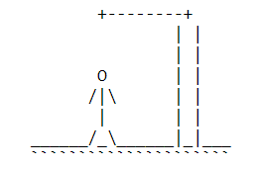
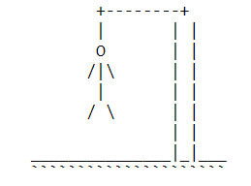
HANGMAN GAME
18ECE201J - PYTHON AND SCIENTIFIC PYTHON
SAI VARDHAN ARANGI
RA1911004010528

Slide 2

About Hangman
Hangman is a guessing game in which the objective of the player is to find out the hidden word. Every incorrect guess leads to the decrement of the chances left for the player.
The chances left are represented in the form of a hanging man. And the job of every hero is to save lives.
The Hangman program randomly selects a secret word from a list of secret words with the help of random module. The Game: Here, a random word (a character name) is picked up from our collection and the player gets limited chances to win the game.
When a letter in that word is guessed correctly, that letter position in the word is made visible. In this way, all letters of the word are to be guessed before all the chances are over.

Slide 3
HANGMAN DESIGN
As we know, after every incorrect move, a new part of the hanging man’s body is displayed. To implement this, we store the body parts in a list.
# Stores the hangman's body values
hangman_values = ['O','/','|','\\','|','/','\\’]
# Stores the hangman's body values to be shown to the player
show_hangman_values = [' ', ' ', ' ', ' ', ' ', ' ', ' ']

Slide 4
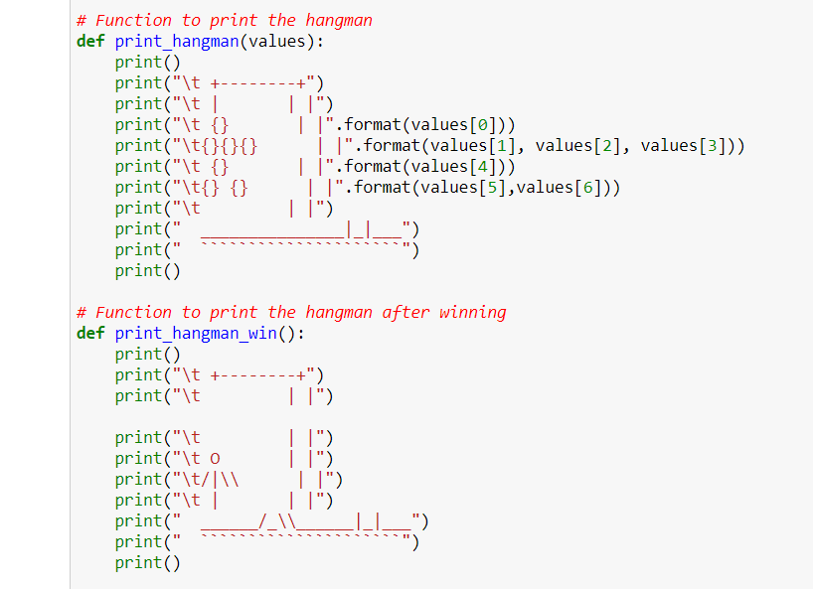
The function that handles these hangman values is presented in previous slide
It displays all the hangman states possible in the game. Each incorrect mistake adds a body part until the body is complete and the player loses.
'print_hangman_win()' takes care of printing the escaped hangman when the player wins.

Slide 5
Data-set For Words
# Types of categories
topics = {1: "DC characters", 2:"Marvel characters", 3:“Countries“, 4:”States”}
# Words in each category
dataset = {"DC characters":["SUPERMAN", "JOKER", "HARLEY QUINN", "GREEN LANTERN", "FLASH", "WONDER WOMAN", "AQUAMAN", "MARTIAN MANHUNTER", "BATMAN"],
"Marvel characters":["CAPTAIN AMERICA", "IRON MAN", "THANOS", “DOCTOR STRANGE", "BLACK PANTHER", "BLACK WIDOW“],
"COUNTRIES":["CHINA", "INDIA", "UNITED STATES","PAKISTAN", "SOUTH AFRICA", "SRILANKA", "CANADA"],
"STATES":["ANDHRAPRADESH","TELANGANA","TAMILNADU","PUNJAB","ASSAM","MAHARASTRA","KARNATAKA"]

Slide 6
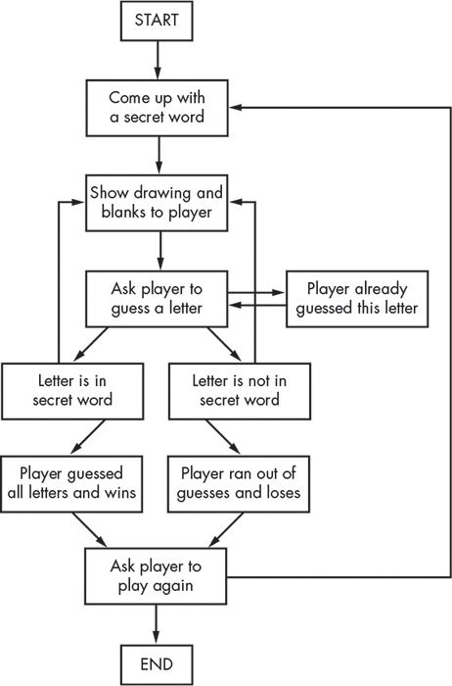
FLO
W C HART

Slide 7
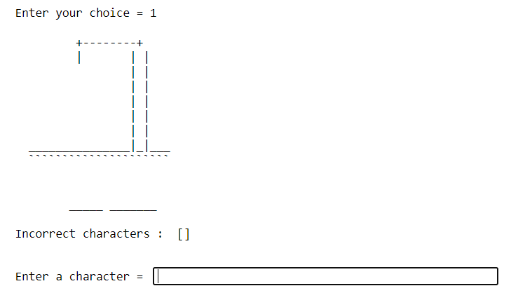
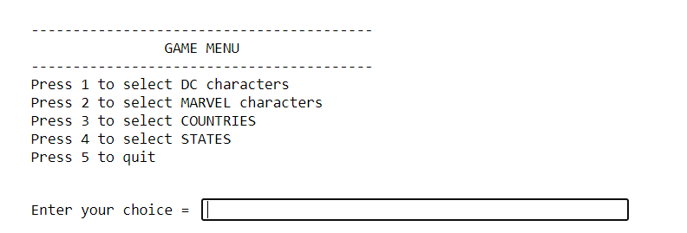
OUTPUT

Slide 8
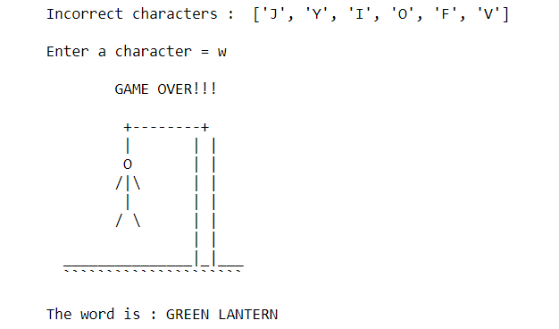
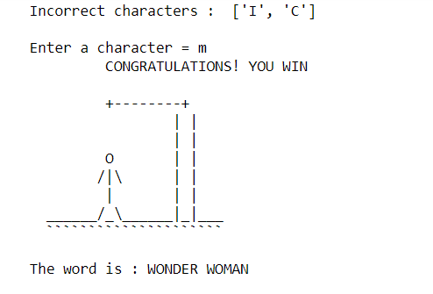
OUTPUT

Slide 9
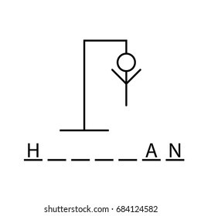
THANK YOU

